Slide 1
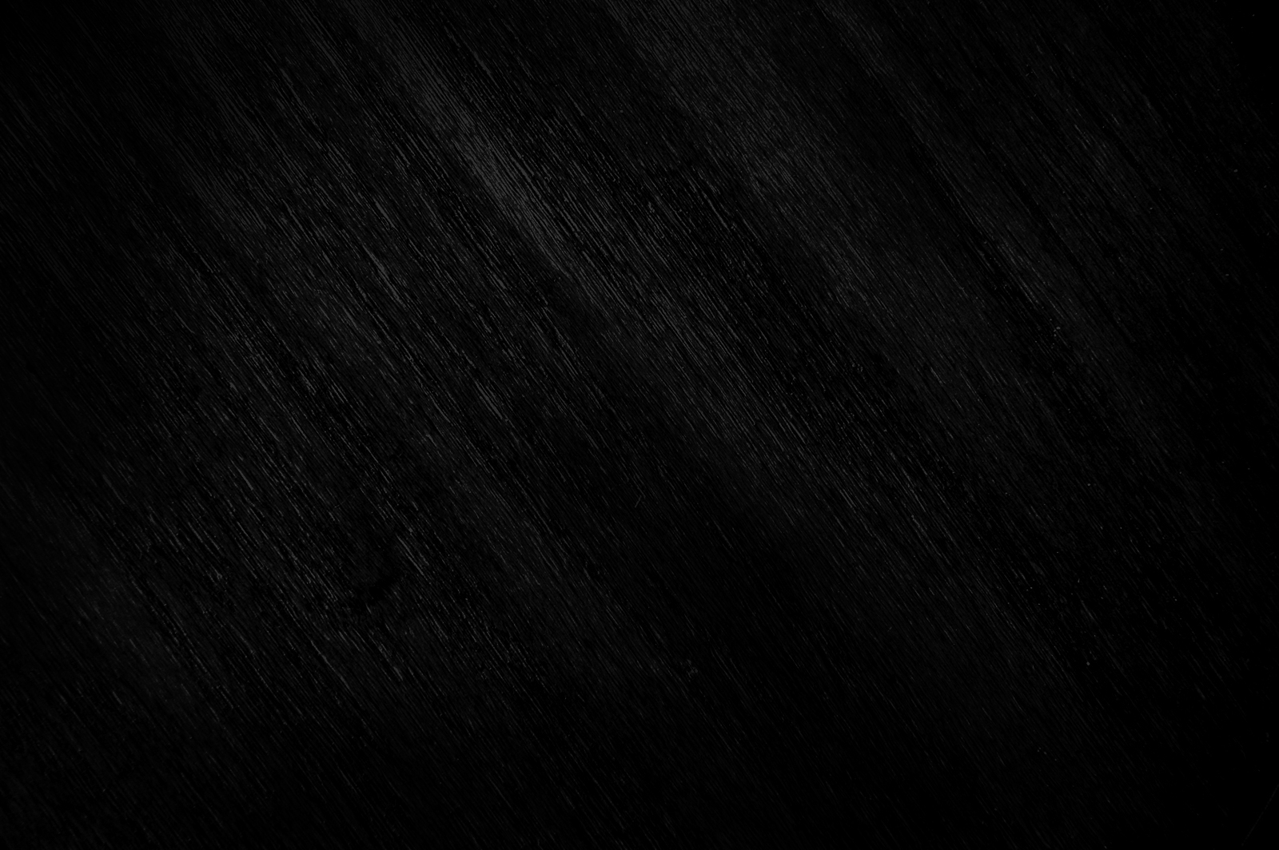
SFX Proposal
Liam McNally - 10368502

Slide 2
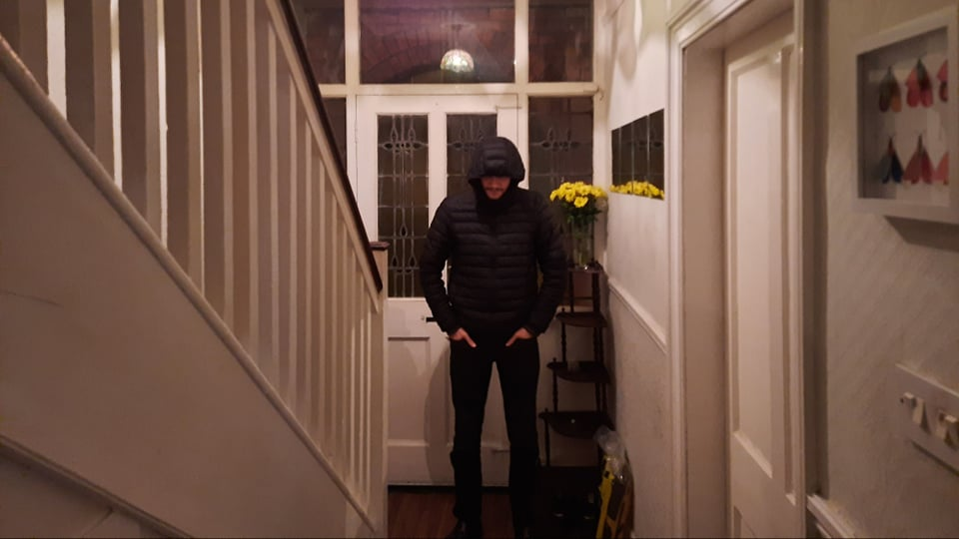
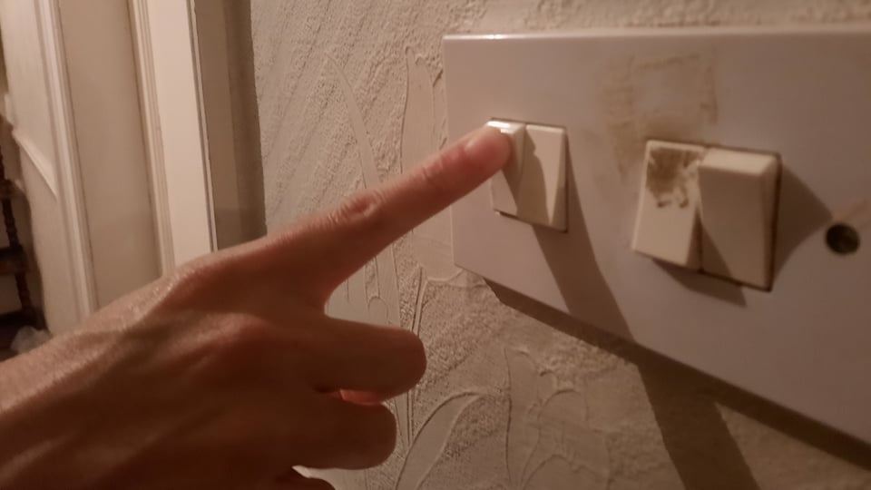
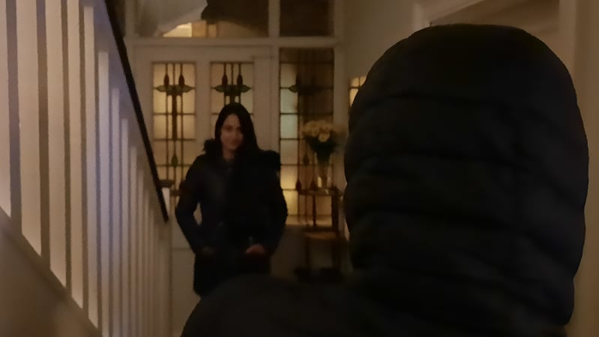
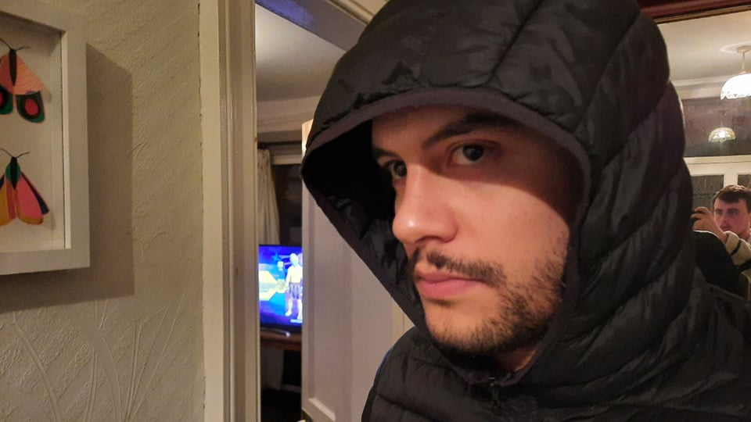
Storyboard proposal for Key scene.
Scene 1
Shot 1
Wide Shot
Scene 1
Shot 2
Close Up
Character walks down hallway.
He flicks off the light switch.
Scene 1
Shot 3
Mid Shot
Scene 1
Shot 4
Close Up
Figure appears at the end of the Hall
Brief hold on his reaction.

Slide 3
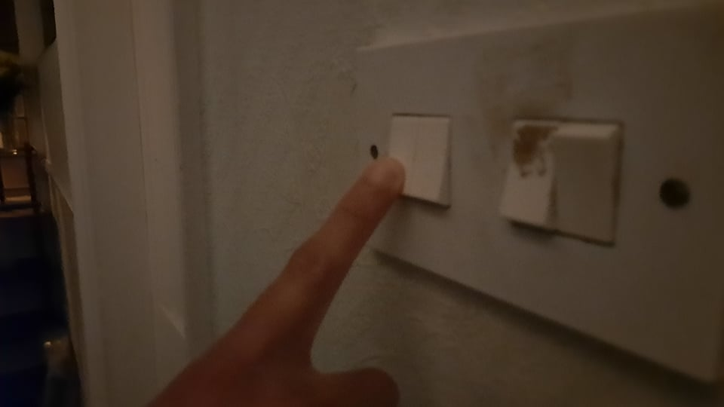
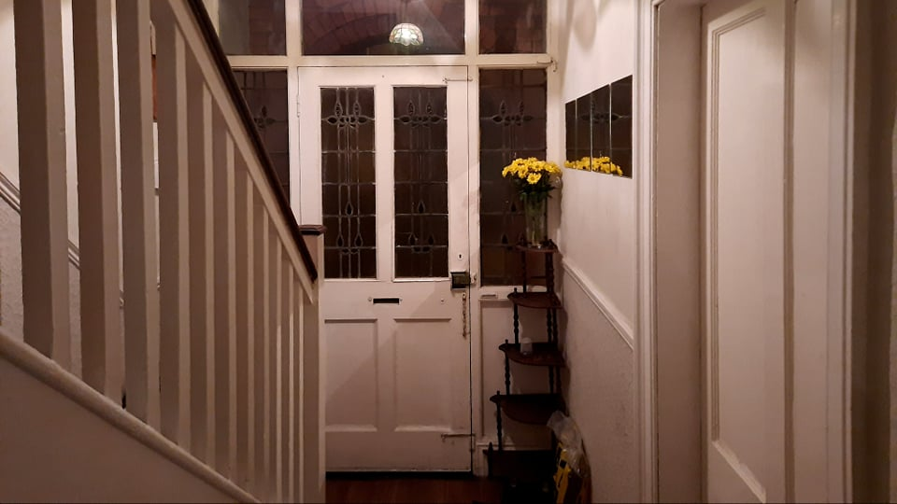
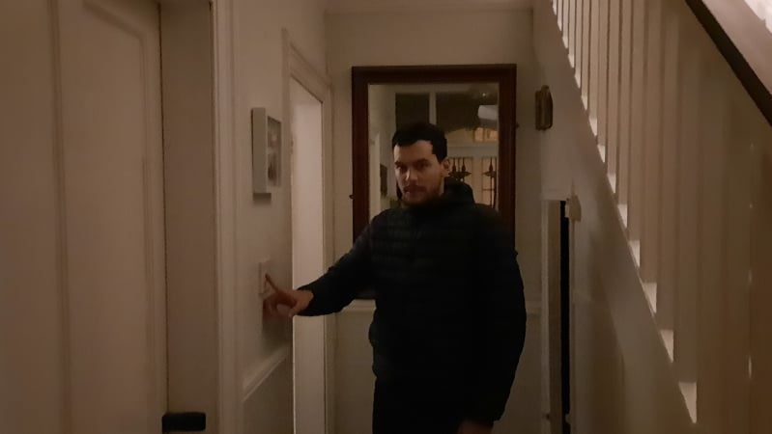
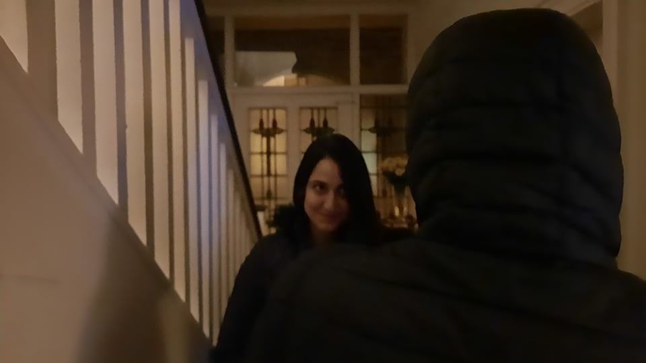
Scene 1
Shot 5
Close up
Scene 1
Shot 6
Mid Shot
He flicks the light back on.
The hallway is empty.
Scene 1
Shot 7
Mid Shot
Scene 1
Shot 8
Mid Shot
Curious, he stares then flips the switch again.
The figure appears in front of him

Slide 4
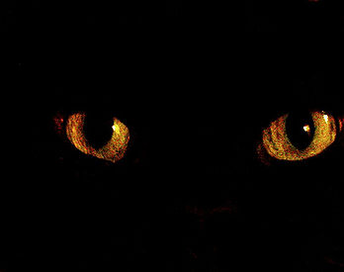
Special Effects concept; Glowing Orange eyes. (Creature at distance and Close Up)

Slide 5
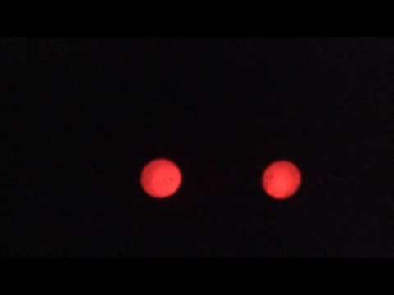
At the end of the hallway.
The concept is inspired by the 'Amityville Horror' (1979) (Pictured Right) In this film this effect was achieved using practical effects.
For the sake of time and convenience on set, this effect will be made in 'After Effects' post shoot. The eyes will be masked on to the figure at the end of the hallway. This way, we save time and extra work on set while not compromising shots and lighting trying to hide practical effects.

Slide 6
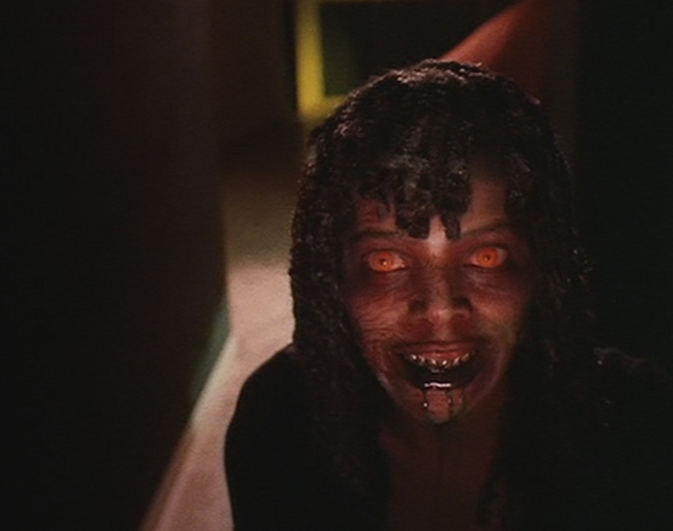
Close up of the Figure.
This concept is taken from 'Demons' (1985) Once in front of our main character the figure will have an altered skin colour with drips coming from the mouth. I feel this look will complement the orange eyes from the end of the hallway.
This effect will be achieved in After Effects.

Slide 7
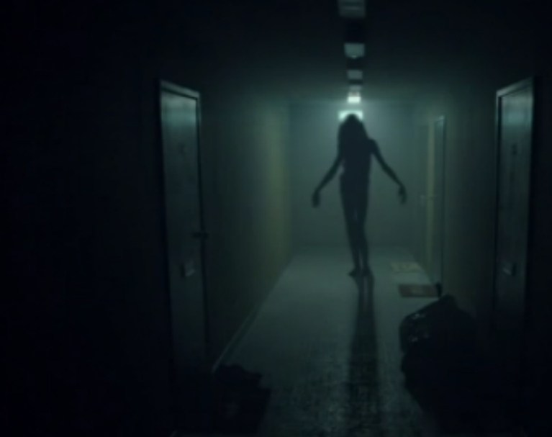
Practical Effects.
The practical effects can be achieved with the right actress and proper lighting in the scene. Example: (Right) 'Don't Knock Twice'
Lighting will be Key to create the atmosphere for the figure. Having strong lighting from behind the figure or even pointing down the hall towards it will do a good job at creating the silhouette of the dark figure in the hallway.

Slide 8
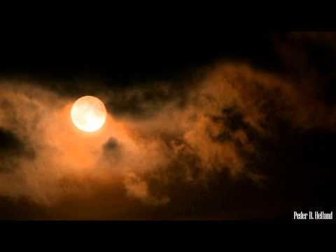
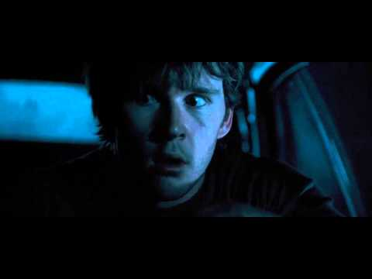
Sound Design
For the sound design in the scene, there will be no music playing in the background at the start of the key scene.
Once our main character turns off the Light and the figure appears there will be a deep, unsettling theme.
Once the figure is revealed at the end of the scene, there will be a subtle music sting as the main character screams.
Selected Theme at 00:20
Jumpscare Sting; 'Dead Silence' (2007)

Slide 9
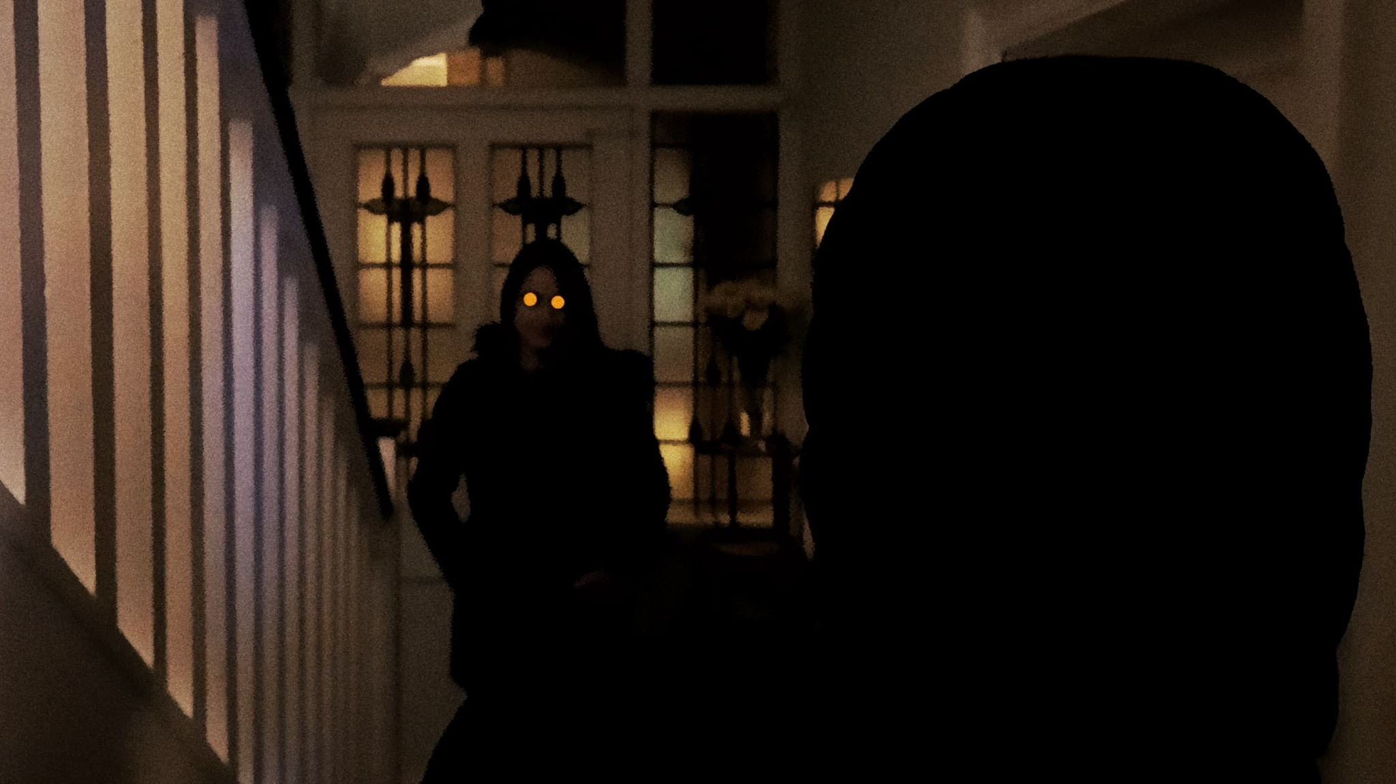
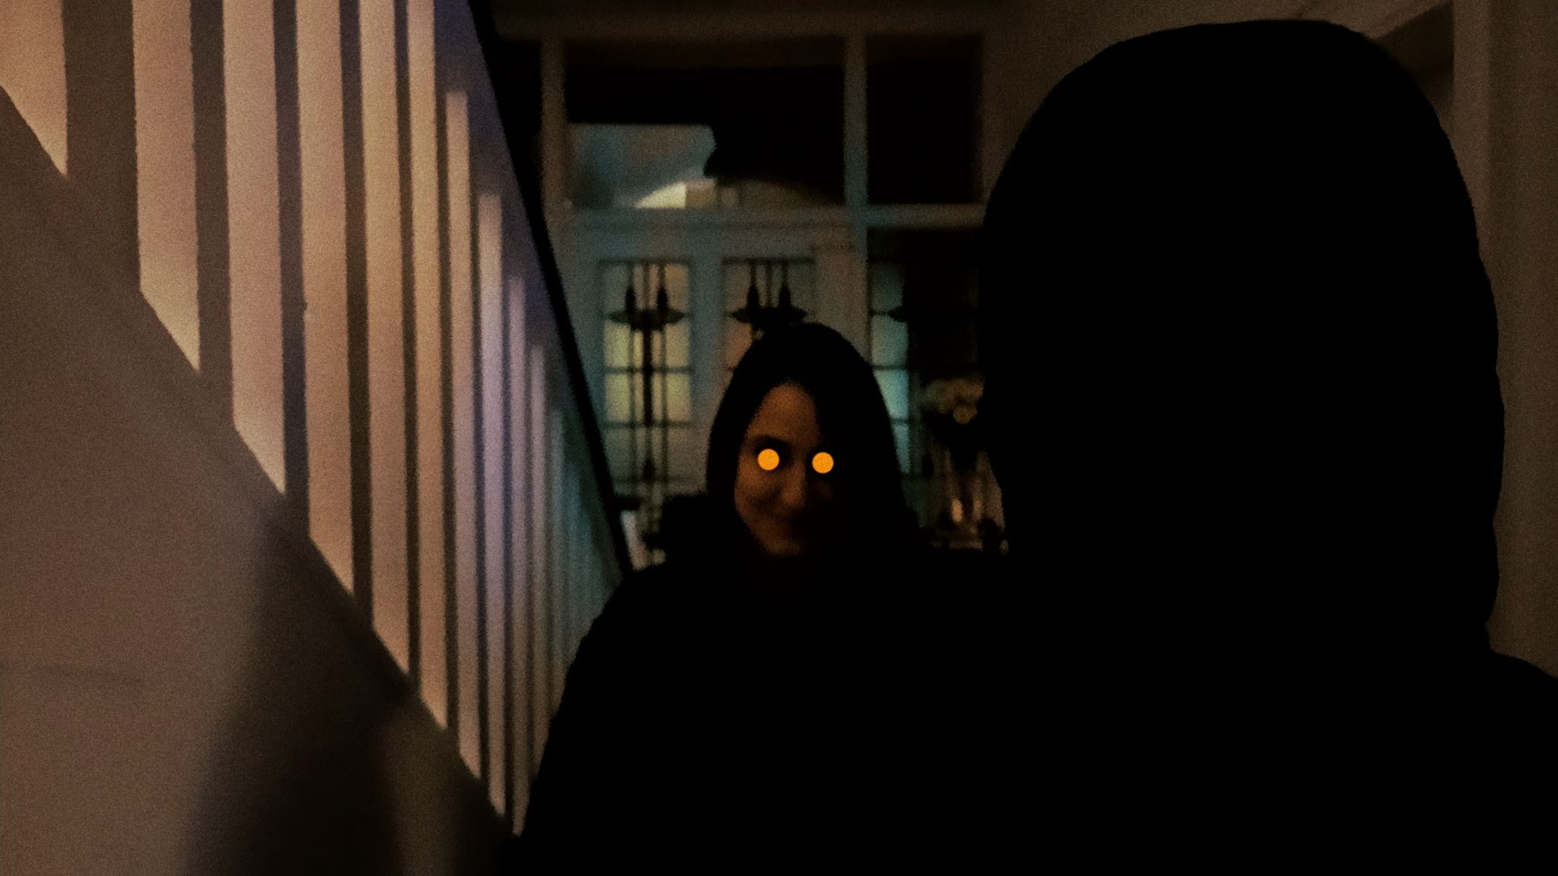
Final concept design.
This is a concept made in photoshop showing what the final design of the figure would look like.
The use of After Effects with good colour correcting and lighting would make the visual effects on the face blend into the shots without sticking out and being obviously a visual effect.
This all together with the practical actor and dark suit / clothing, lighting and sound design would create the eerie atmosphere that comes across in the Script.

